Slide 1

Geometry
Unit 11, Lesson 9 Solving Problems Using Triangle Relationships Volume 2 pg. 225

Slide 2


Benchmark
MA.912.GR.1.3
Prove relationships and theorems about triangles. Solve mathematical and real-world problems involving postulates, relationships, and theorems of triangles.
volume 2, pg. 225

Slide 3
Integrated Mathematical Thinking and Reasoning Standards
MA.K12.MTR.1.1 Actively participate in effortful learning both individually and collectively.
MA.K12.MTR.3.1 Complete tasks with mathematical fluency.
MA.K12.MTR.4.1 Engage in discussions that reflect on the mathematical thinking of self and others.
MA.K12.MTR.5.1 Use patterns and structure to help understand and connect mathematical concepts.
volume 2, pg. 225

Slide 4

Learning Target
I can solve mathematical and real-world problems involving postulates, relationships, and theorems of triangles.
volume 2, pg. 225

Slide 5

Warm-Up
volume 2, pg. 225

Slide 6
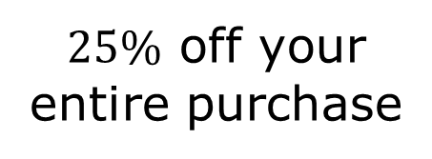
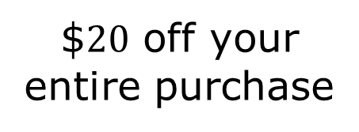
11.9.1 Warm-Up: Would You Rather?
Would you rather use a coupon worth …
OR
Explain your choice.
$$20$ off your entire purchase
$25\%$ off your entire purchase
volume 2, pg. 225

Slide 7

Activity
volume 2, pg. 226

Slide 8

11.9.2 Activity: Triangle Relationships
For each problem, record your work and answer in the table.
Problem Letter | Work | Answer
A
B
C
volume 2, pg. 226

Slide 9
Problem Letter | Work | Answer
D
E
F
G
volume 2, pg. 226

Slide 10

Wrap-Up
volume 2, pg. 227

Slide 11
11.9.3 Wrap-Up: Cool Down
Write a summary of what you learned in this lesson.
volume 2, pg. 227

